Slide 1
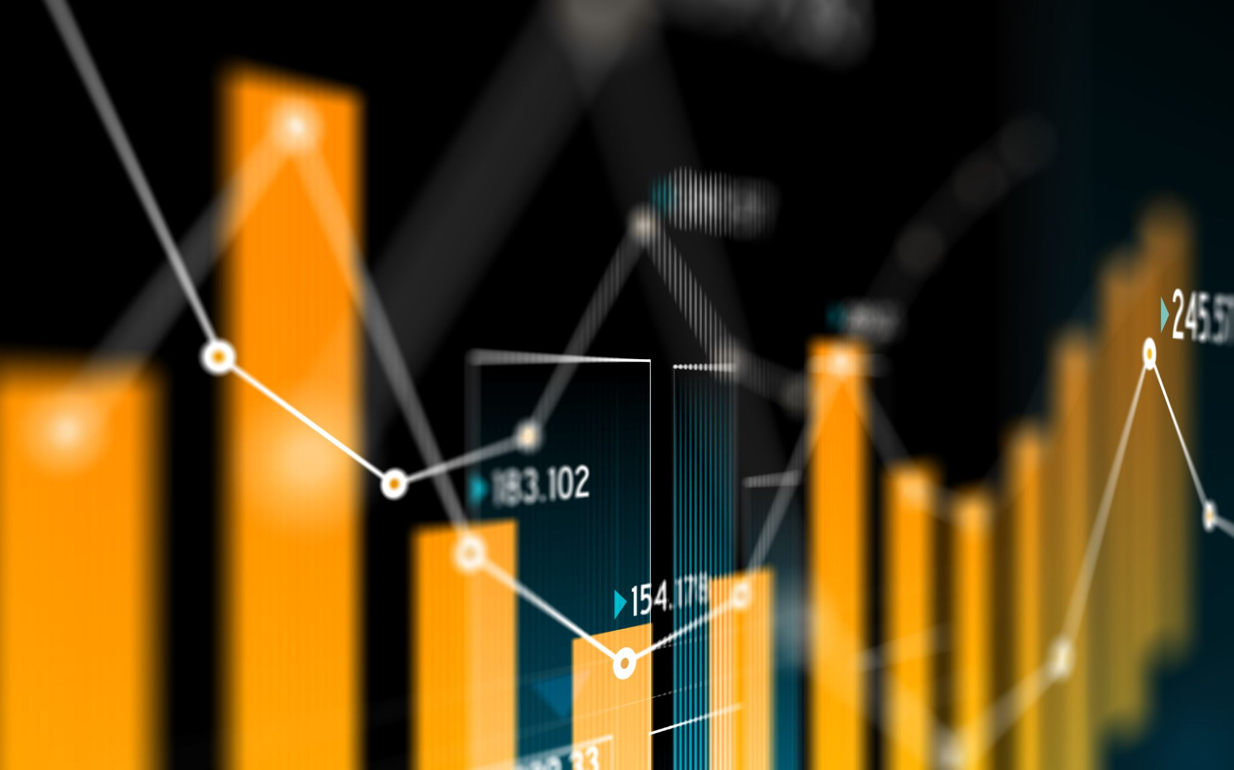

Market Basket Analysis and Customer Segmentation
DATA 603: Platforms for Big Data Processing
Aishwarya Kale, Sarang Patil , Sushruth DT
Under the guidance of
Dr. Waleed Youssef

Slide 2




Team Members
Aishwarya
Sarang
Sushruth

Slide 3
Project Abstract
Have you ever wondered how Amazon, Netflix and Spotify make product recommendations? At the heart of these systems is a technique called Market Basket Analysis. In today’s world, huge amount of data is being generated and collected on a large scale. However, it is not being used to its full potential.
Market basket analysis is a subset of product affinity analysis that retailers use to discover buying patterns and the relationships between items. It is a data mining technique used by retailers to increase sales by better understanding customer purchasing patterns. It involves analyzing large data sets, such as purchase history, to reveal product groupings, as well as products that are likely to be purchased together.
Online retailers often associate it with phrases like "customers who purchased this item also bought" or Netflix's "See what’s next." With the consumers and retailers becoming heavily reliant on recommendation engines for incremental purchases, market basket analysis is emerging as the key driver of upselling and cross-selling in eCommerce.

Slide 4
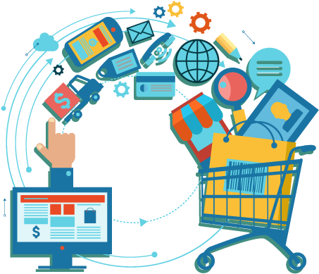
Project Objective
The project focuses on using market basket analysis in online retail industry to associate related products based on customer buying behaviour.
Using market basket analysis we have three objectives:
Product Association: Finding combinations of items that occur together frequently in transactions.
Customer Segmentation: Clustering customers into groups that represent similarity among other customers in each group.
Predicting probability of reorders: Determining predictability of reorders based on the frequency of orders and customer group.

Slide 5






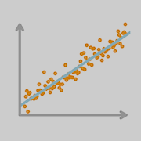
Accomplisments
1
Market Basket Analysis
Identifying frequent product pairings using Association Algorithm
Use Cases Achieved
2
Customer Segmentation
Clustering customers into groups based on shared characteristics using K-Means algorithm
3
Reorder Prediction
Predicting reorders based on order frequency and customer group using Classification Algorithms

Slide 6

Dataset Overview
SIZE : 3 GB (merged) | Dataset Source: Kaggle ‘Instacart’ Dataset 3 million+ grocery orders of more than 200,000 Instacart users and the week and hour of day the order was placed
Orders.csv | order_id: order identifier, user_id: customer identifier, eval_set, order_number: the order number for the user , order_dow: the day of the week the order was placed on, order_hour_of_day: the hour of the day the order was placed on, days_since_prior: days since the last order.
Products.csv | product_id: product identifier, product_name: name of the product, aisle_id: foreign key, department_id: foreign key
Aisles.csv | aisle_id: aisle identifier, aisle: the name of the aisle.
Departments.csv | department_id: department identifier, department: the name of the department
order_products_prior .csv | order_id: foreign key, product_id: foreign key, add_to_cart_order: order in which each product was added to cart, reordered: 1 if this product has been ordered by this user in the past, 0 otherwise, “prior”: orders prior to that users most recent order.

Slide 7
Project Updates
Removing Kafka component
SQL database was used in place of MongoDB.
Integrated Databricks as Data IDE environment
Kafka component was removed due to integration issues caused by the large dataset.
MongoDB was replaced with SQL , as the data was structured.
Integrated Data Bricks is a cloud-based tool for data engineering.

Slide 8
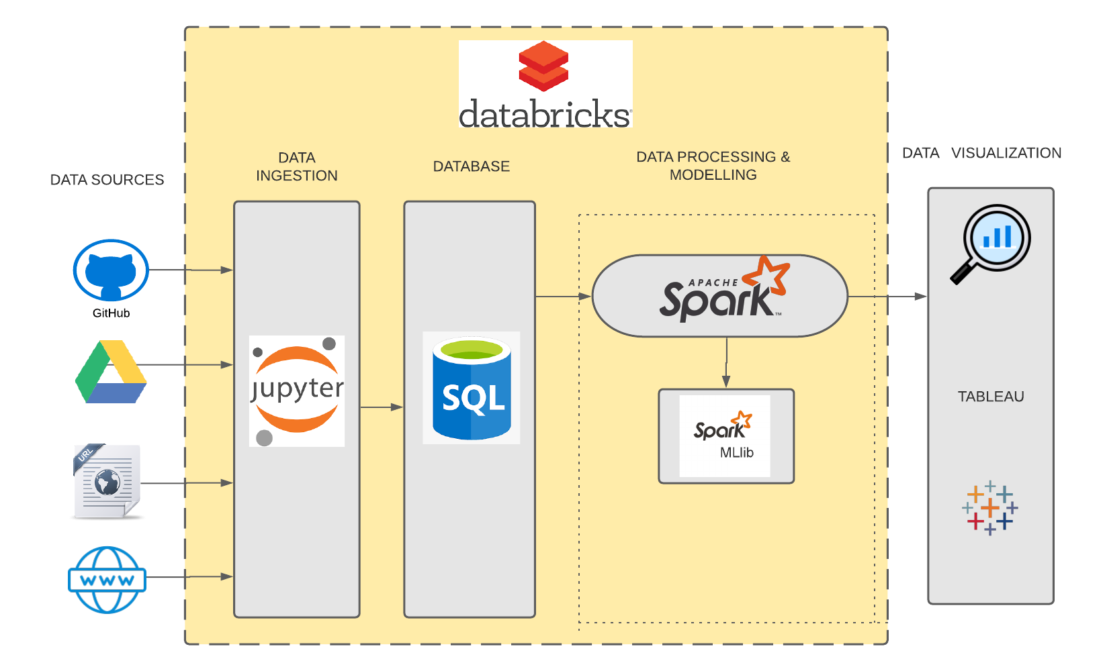
System Architecture

Slide 9





Methodology
5
4
3
2
1
Dataset Preparation
Data Preparation
Exploratory Data Analysis
Modeling
Interpret Results
3.5GB Data Ingestion from different sources
Data Merging, Data Cleanup, Feature Engineering
Model Training, Parameter Tuning, Model Tuning, Model Validation
Visualizations and Insights, Descriptive Analysis,
Model Evaluation, Communicate Results

Slide 10
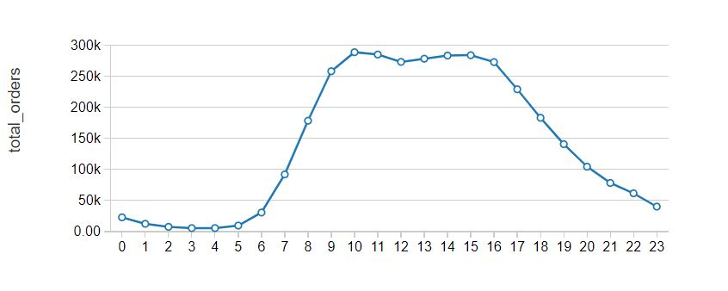
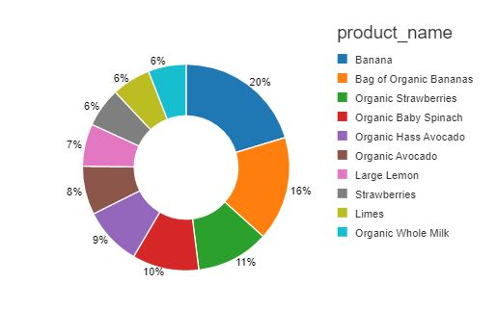
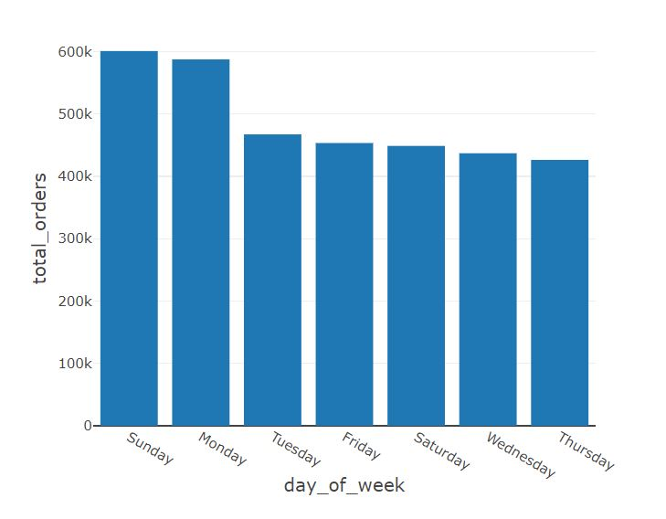
Between the hours of 9 a.m. and 6 p.m. customers are more likely to place an order.
Almost 50% of the items purchased belong from just 2 departments which are ‘produce’ and ‘dairy eggs’
Sunday and Monday are the busiest days of the week, with Thursday being the least busy.
Some Data Insights

Slide 11
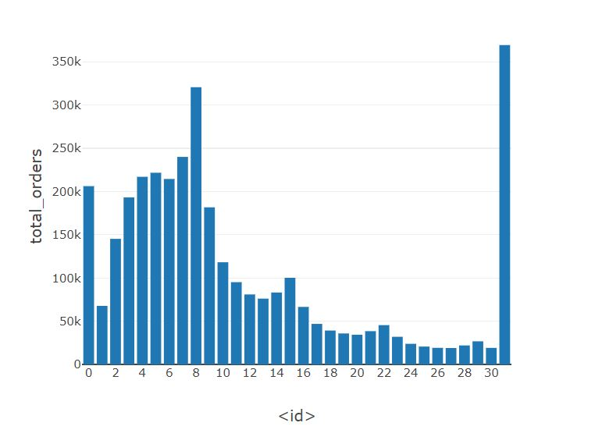
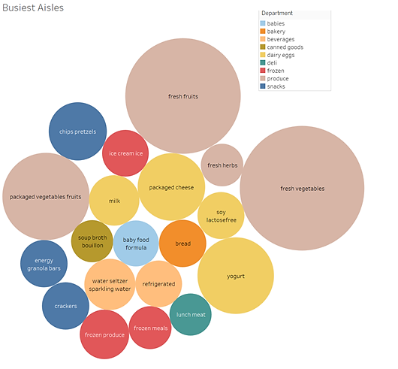
Because the 'days since prior' column is capped at 30 days, a large number of customers place their order 30 days or later.
Fruits and Vegetables Aisle constitute major transactions, compared to Other Aisles.
Least visited Aisles are energy bars, crackers, lunch meat
Some Data Insights

Slide 12
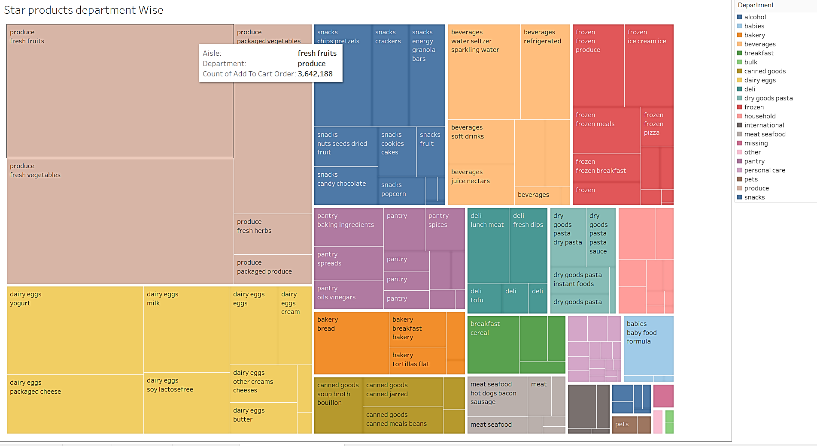
Produce and Dairy department has most transactions compared to others
Fruits, vegetables, yogurt, milk, chips, and bread are just a few of the department's best-selling products.
Some Data Insights

Slide 13
Market Basket Analysis
Association Rule : Frequent Pattern Growth Algorithm

Slide 14
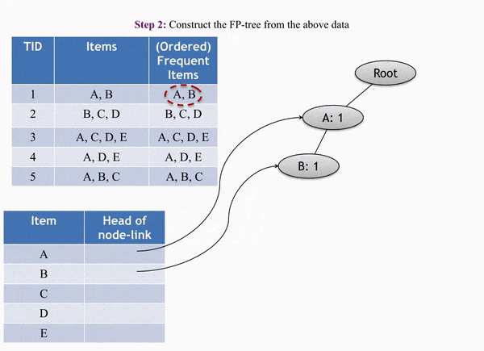


FP Growth-Association Algorithm
Frequent Pattern Growth Algorithm, the compressed representation of the itemset database is the FP tree. The tree structure not only stores the itemset in the database, but it also keeps track of the relationships between item sets.
Each itemset is mapped to a path in the tree one at a time, resulting in the tree. The entire concept behind this structure is that.
Click the above image to play .gif

Slide 15
Methodology
Basket Creation
FP growth Modelling
Frequent Item sets display
Item sets Association rules display
Data Merging
Data Processing
Merging 5 Entity Data into One Data Frame
Data Cleanup, Feature Selection
Creating baskets of each order in our dataset
Implementation of FP-growth algorithm using Py Spark
model.freqItemsets.show()
model.associationRules.show()

Slide 16
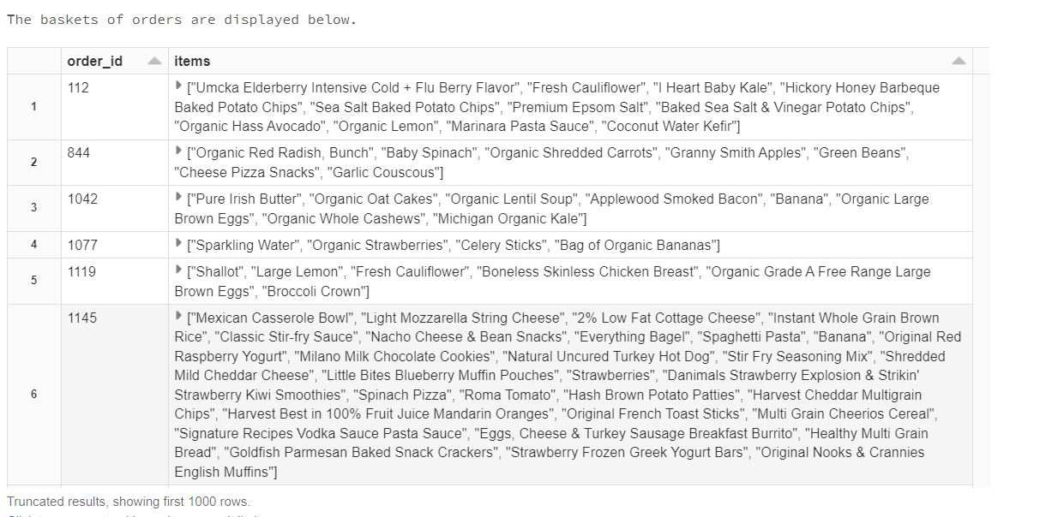
Results : Market Baskets
The below table shows list of products (baskets) in each order of user.

Slide 17
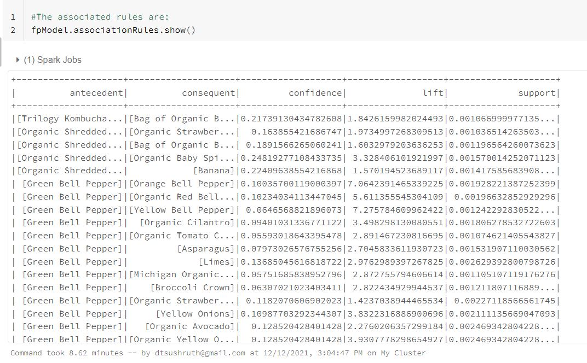
Results : Association Rules
Below table shows association rules of baskets, with its confidence, lift and support:

Slide 18
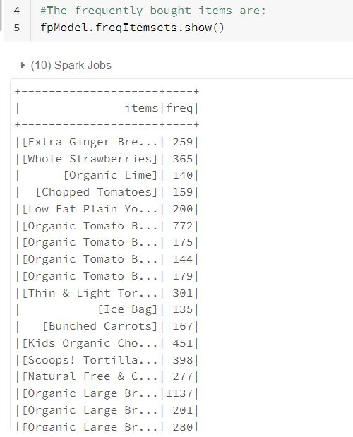
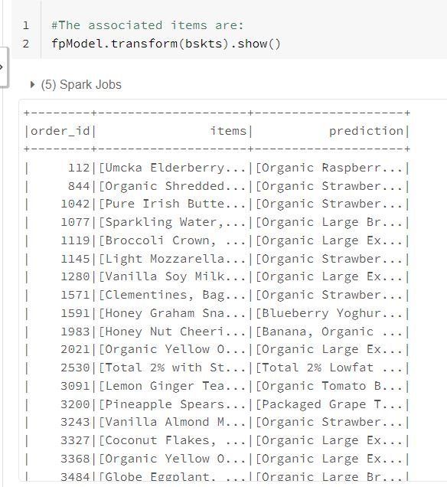
Results : Predicting items to be ordered
Below table shows frequently ordered items:
Below table shows predictions on what the customer might buy based on his basket:

Slide 19
Market Basket Analysis
Customer Segmentation using K-Means Algorithm

Slide 20
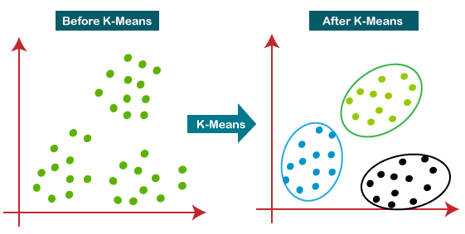
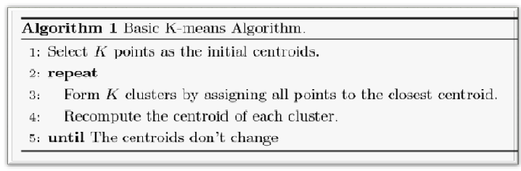
Customer Segmentation : K-means Clustering
Customer Segmentation is the subdivision of a market into discrete customer groups that share similar characteristics.
Useful to identify unsatisfied customer needs and to maximize the value of each customer to the business.
K-Means clustering is an unsupervised machine learning algorithm that divides the given data of customers into the given number of clusters where” is number of predefined clusters.
It helps to surface insights and groupings that marketers might find difficulty discovering
It is a centroid based algorithm, and the idea is to reduce the distance between the data points and their respective cluster centroid.

Slide 21

Methodology
Data Load from DB & Feature Selection:
product_name, aisle_name, department_name, order_dow, order_hour_of_day, days_since_prior, reordered.
Data Processing:
1. Handling Categorical Data: String Indexer & One Hot Encoding from spark ML Lib
2. Handling Numerical Data : Using Imputer
3. Vector Assembler for obtaining features.
Determine K clusters with Elbow Method:
Using Silhouette score & Euclidean Distance.
Hence, K = 3
Implement K-Means Clustering :
Assigning users to predicted clusters
Visualization of clusters :
1.Using PCA to display 2D view of clusters,
2.Parallel plots

Slide 22
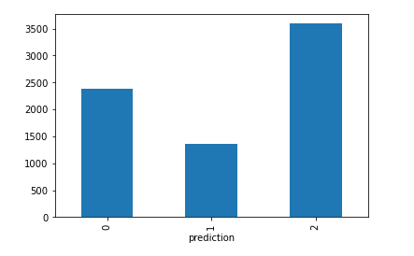
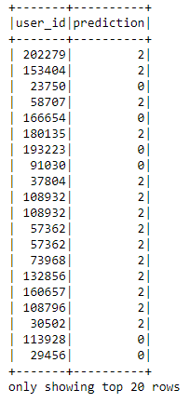
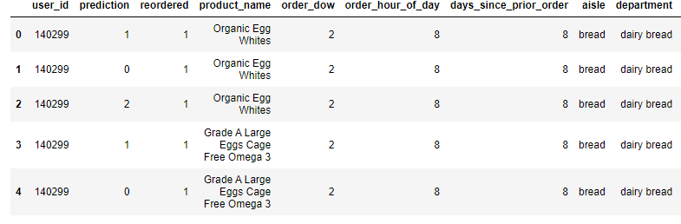
Results
Visualize Users in Clusters
Clusters (Prediction ) assigned to the Users
Most of the customers belongs to 2nd Clusters followed by 0th Clusters.

Slide 23
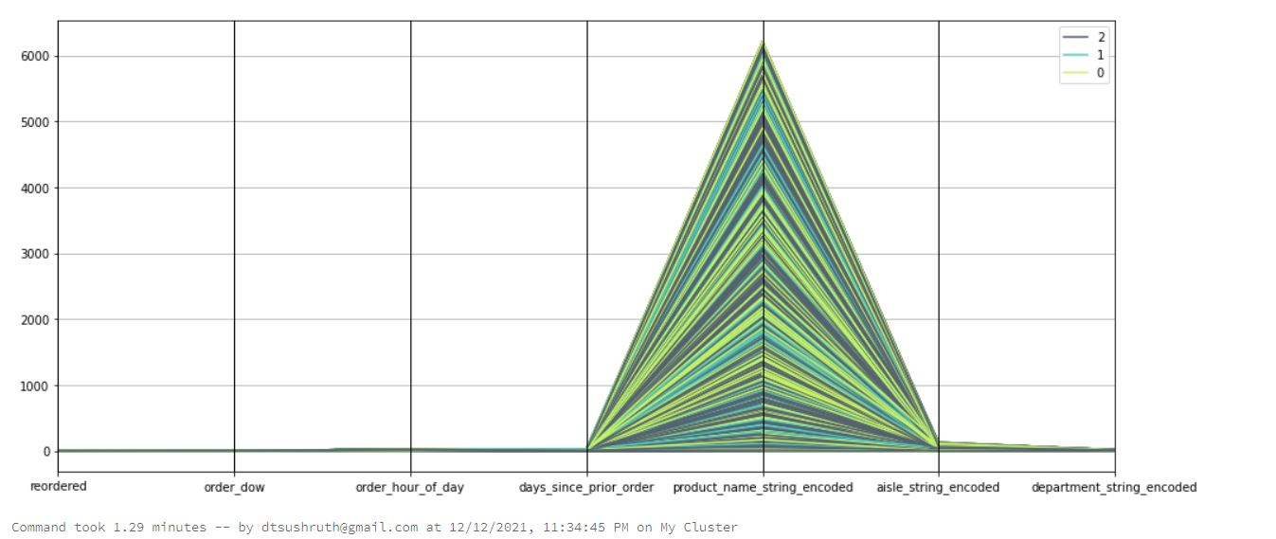
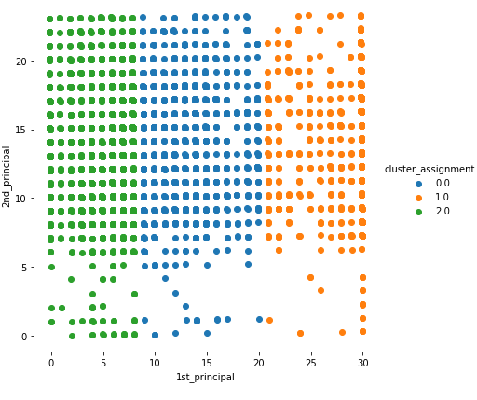
Visualization
Using Parallel Plot
Using PCA for 2D view

Slide 24
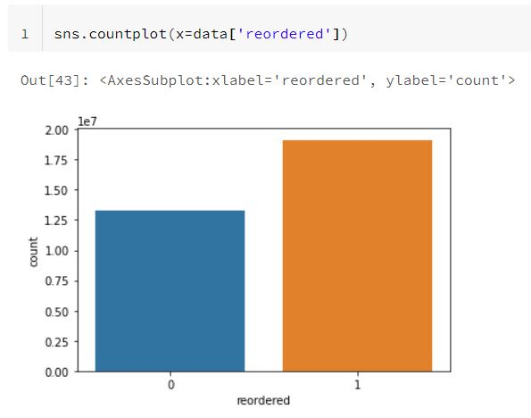
Visualization: Distribution of label
The distribution of whether orders are reordered or not is portrayed below.

Slide 25
Market Basket Analysis
Reorder Prediction using Classification Algorithms

Slide 26
Reorder Prediction using Classification Algorithm
The task is to predict which products a user likely to reorder in their next purchase.
The task is formulated as a binary prediction task given user product and his purchase history to predict whether the given product will be reordered in user next order.
We used two algorithms logistic regression and naïve bayes for predicting whether the product will be reordered or not, and the probability of the reorder.
We tried under sampling, oversampling, as well as PCA, but it either caused severe underfitting or overfitting.
Accuracy of Logistic Regression | Accuracy of Naïve Bayes
70% | 67%

Slide 27
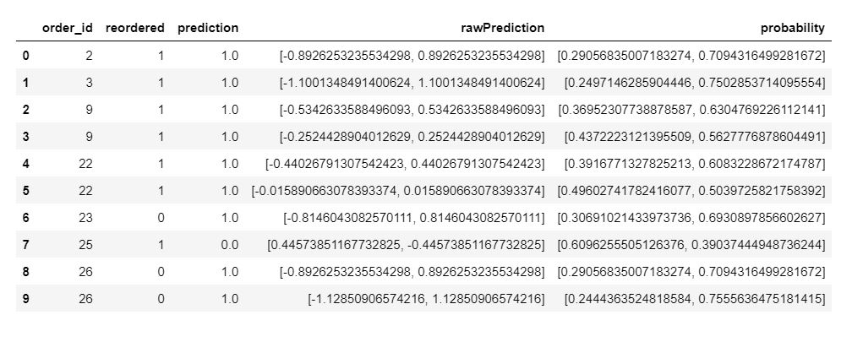
Reorder Prediction - Logistic Regression
Below shows the Logistic Regression prediction values and probability whether the order would be reordered

Slide 28
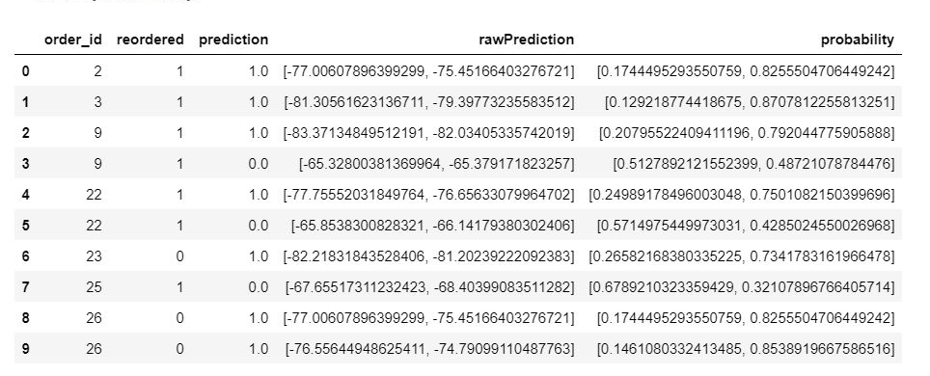
Reorder Prediction : Naïve Bayes
Below shows the Naïve Bayes prediction values and probability whether the order would be reordered

Slide 29
Reorder Prediction Steps
Data loading
Model Training
Data merging
Data Processing
Loads and fetch datasets from SQL via dbfs file store
Merge all datasets together based on User_ID
Training model and Evaluation
Accuracy
Predictions
Probability
Split datasets into 70% training and 30% testing data.
Results
Data Cleanup

Slide 30
Real Life Use-Cases
Market Basket Analysis
Cross selling of Items
Store Aisle Design
Customer Retention
Customer Behavior
Affinity Promotion

Slide 31
References
https://medium.com/analytics-vidhya/shopper-behavior-exploration-and-market-basket-analysis-using-spark-650656d6a0e1
https://s3.us-east-2.amazonaws.com/databricks-dennylee/notebooks/Market+Basket+Analysis+using+Instacart+Online+Grocery+Dataset.html
https://spark.apache.org/docs/latest/ml-classification-regression.html
https://medium.com/@junwan01/oversampling-and-undersampling-with-pyspark-5dbc25cdf253
https://rsandstroem.github.io/sparkkmeans.html
https://www.data4v.com/tutorial-k-means-clustering-on-spark/

Slide 32

Thankyou!!

